Slide 1
Credit Default Detector
Joel Choe
Amogh Gupte
Chintan Mehta
Amit Rajwani

Slide 2
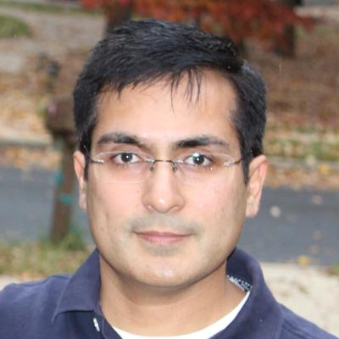
The Team
Joel Choe
Associate on the OTC Derivatives team within Basel Measurement & Analytics
First got interested in data/analytics because of fantasy basketball
Favorite Quote: "You come at the king, you best not miss." - Omar Little from "The Wire"
Chintan Mehta
Chintan has been with JP Morgan Chase more than 8 years and currently working as Strategic Business Analyst with CCB Remediation and Corrections team. I like to travel and explore new places, listening classical Indian music and Bollywood songs and watching movies.
Amogh Gupte
Amogh has been with JP Morgan for the last 12 years as a Java developer in the corporate tech space. He loves hiking spending time with kids.
Amit Rajwani
Amit works in CCB Credit Card Technology for the C3 Authorizations Platform as an Agility Lead. He has been with the firm for 8 years and likes to travel and be outdoors with nature.

Slide 3
Executive Summary
In 2019(Pre Covid), JP Morgan reported $5.6 billion net charge-offs.
Our aim is to build a scalable, automated solution to predict defaults.
Our best model (with open-sourced data) was able to catch about 65% of the defaults.
Notes:
Dataset
The dataset we selected from Kaggle contains information about credit card loan transactions from a credit risk perspective. It's a large dataset containing 122 attributes and over 300K records pertaining to the customer and loan. We also have a target variable that specifies whether the loan was good or default
Why this Dataset
The consumer lending line of business @ JPMC is in the business of lending money to customers for loans, credit cards, mortgage, etc. and a model like this which can predict potential defaults would be immensely helpful in making lending decisions. It could also be used to help JPMC identify and train their customers for credit discipline to avoid potential defaults. Since the dataset is something we could relate to and have some domain knowledge we selected it for our Capstone project
Solution Approach
This is a supervised classification problem since we are using existing features and target variable to first train the model on a subset of data and then evaluate the model's performance on the test data. We would pick the model that best meets the criteria of accuracy and performance. The aim is to use the data to come up with a classification model, to approve or reject the loan request by building a scalable, repeatable service to give real time approval decisions.

Slide 4
AI Canvas : Using Machine Learning for Credit Card Loan Approval Decisions
Investigate use of machine learning to see what insights and potential benefits can be created when applied to the loan approval process
Looking for more nuance than traditional decision-making process based on credit history/score that maximizes revenue
Made use of dataset via Kaggle containing information about credit card loan transactions (122 attributes and over 300k records)

Slide 5
Critical Aspects of Decision
Prediction
Predict whether a loan applicant will default
Judgement
For this use-case catching the default case is more important, as if a client defaults the firm will loose the whole credit amount. In 2019(Pre Covid), JP Morgan reported $5.6 billion net charge-offs.
On the other hand, if we classify someone as default, the firm may loose the business.
Action
Default or Not default
Outcome
Recall on the testing data is the main criteria here
Notes:
Compare the cost/benefit of rejecting potential applicants who would repay full loan amount vs accepting potential applicants who eventually default

Slide 6
Key observations of the dataset & Pre-processing
This is an imbalanced dataset. There are far more loans that were repaid on time than loans that were not repaid
Mean employment tenure is skewed due to outliers and needs to be filtered to get a better model
The Risk of Failure to repay was higher in the younger age group as compared to older applicants. As the age increased the risk decreased
We handled missing data, data errors and outliers
A large number of attributes were dropped since they either provided duplicate information or were insignificant in model performance

Slide 7
Input
Column Name | Column Description
AMT_ANNUITY | Loan annuity
AMT_CREDIT | Credit amount of the loan
AMT_GOODS_PRICE | For consumer loans it is the price of the goods for which the loan is given
AMT_INCOME_TOTAL | Income of the client
AMT_REQ_CREDIT_BUREAU_YEAR | Number of enquiries to Credit Bureau about the client one day year (excluding last 3 months before application)
DAYS_BIRTH | Client's age in years at the time of application
DAYS_EMPLOYED | How many months before the application the person started current employment

Slide 8
Model Selection
With our project:
A false positive will mean that the firm will lose the business of a potential 'good' client.
A false negative will result in the firm losing money due to loaning to a defaulter client.
From the above we believe that a false negative will have a higher impact to model performance. We have compared the below models and come up with Logistic Regression model as it will give us the best recall for defaulters in test data. KNN also has the same recall, but it has a higher false positive rate than Logistic Regression.
Comparing our chosen model to the baseline (marking all applicants as not default):
Baseline Accuracy Score : 0.9159
Our Best Accuracy Score : 0.91527
Baseline Recall Score : 0.0
Model Recall Score : 0.658
Name | Accuracy | Recall
Decision Tree | 60.6% | 57.9%
Random Forest | 91.4% | 0.7%
Logistic | 56.3% | 65.8%
KNN | 84.8% | 10.8%
XGBoost | 89.5% | 7.1%
As it can be seen our model gives considerably better Recall over the baseline for defaulter case.

Slide 9
Feedback
We ran the various classifiers through different configurations
For Logistic Regression (Chosen solution), we tried:
Constant: [1.0, 0.5, 0.2, 1.5]
Penalty: [L2, none]
Solver: [newton-cg, lbfgs, liblinear, sag, saga]
With best results from:
Constant: 1.0
Penalty: none
Solver: sag
Notes:
C - To solve this, as well as minimizing the error as already discussed, you add to what is minimized and also minimize a function that penalizes large values of the parameters. Most often the function is λΣθ_{j}², which is some constant λ times the sum of the squared parameter values θ_{j}². The larger λ is the less likely it is that the parameters will be increased in magnitude simply to adjust for small perturbations in the data. In your case however, rather than specifying λ, you specify C=1/λ.
Penalty: loss function
L1: L1-norm loss function is also known as least absolute deviations (LAD), least absolute errors (LAE). It is basically minimizing the sum of the absolute differences (S) between the target value (Y_{i}) and the estimated values (f(x_{i}))
L2: L2-norm loss function is also known as least squares error (LSE). It is basically minimizing the sum of the square of the differences (S) between the target value (Y_{i}) and the estimated values (f(x_{i})
Sag: SAG solver for Ridge and LogisticRegression. SAG stands for Stochastic Average Gradient: the gradient of the loss is estimated each sample at a time and the model is updated along the way with a constant learning rate.

Slide 10
Demo & Repo
https://slackers-ml.herokuapp.com/
https://github.com/amoghugupte/Slackers-Capstone

Slide 11
Solution
Solution approach
This is a supervised classification problem since we are using existing features and target variable to first train the model on a subset of data and then evaluate the model's performance on the test data. We would pick the model that best meets the criteria of accuracy and performance. We are trying to predict if a loan request from a customer will default.
Value to JP Morgan
The consumer lending line of business @ JPMC is in the business of lending money to customers for loans, credit cards, mortgage, etc. and a model like this which can predict potential defaults would be immensely helpful in making lending decisions, Also help JPMC to identify and train their customers for credit discipline.
Aim of the project
Use the data to come up with a classification model, to approve or reject the application. Eventually build a scalable, repeatable service to give live classification decisions.
Plan for deliverables
All code and analysis will be checkin in github: https://github.com/amoghugupte/Slackers-Capstone
Notes:
Delete in final ppt

Slide 12
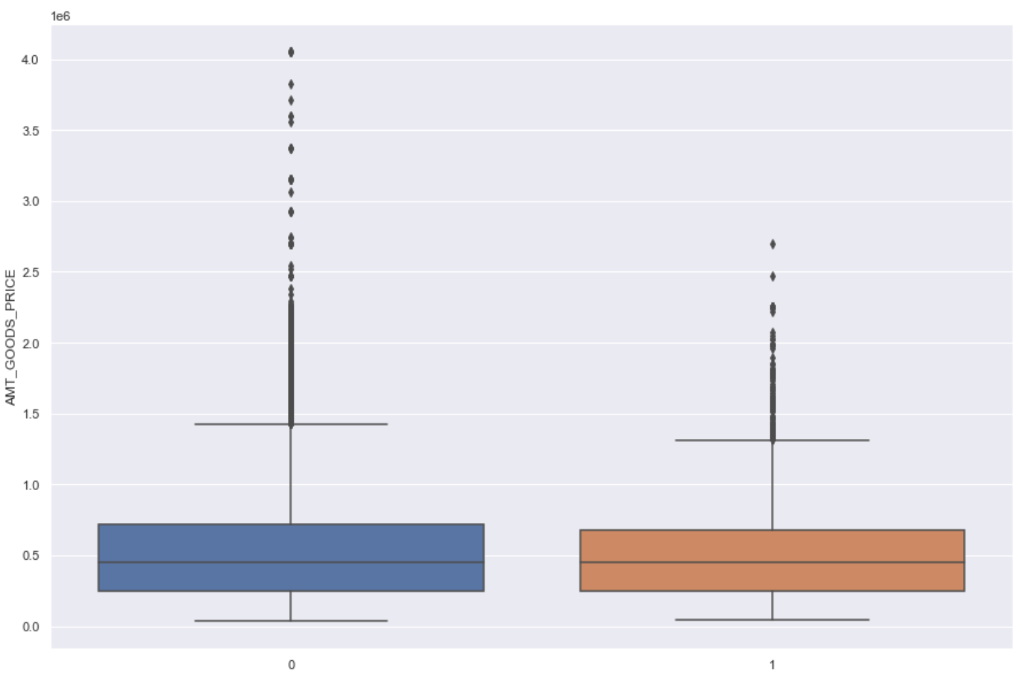
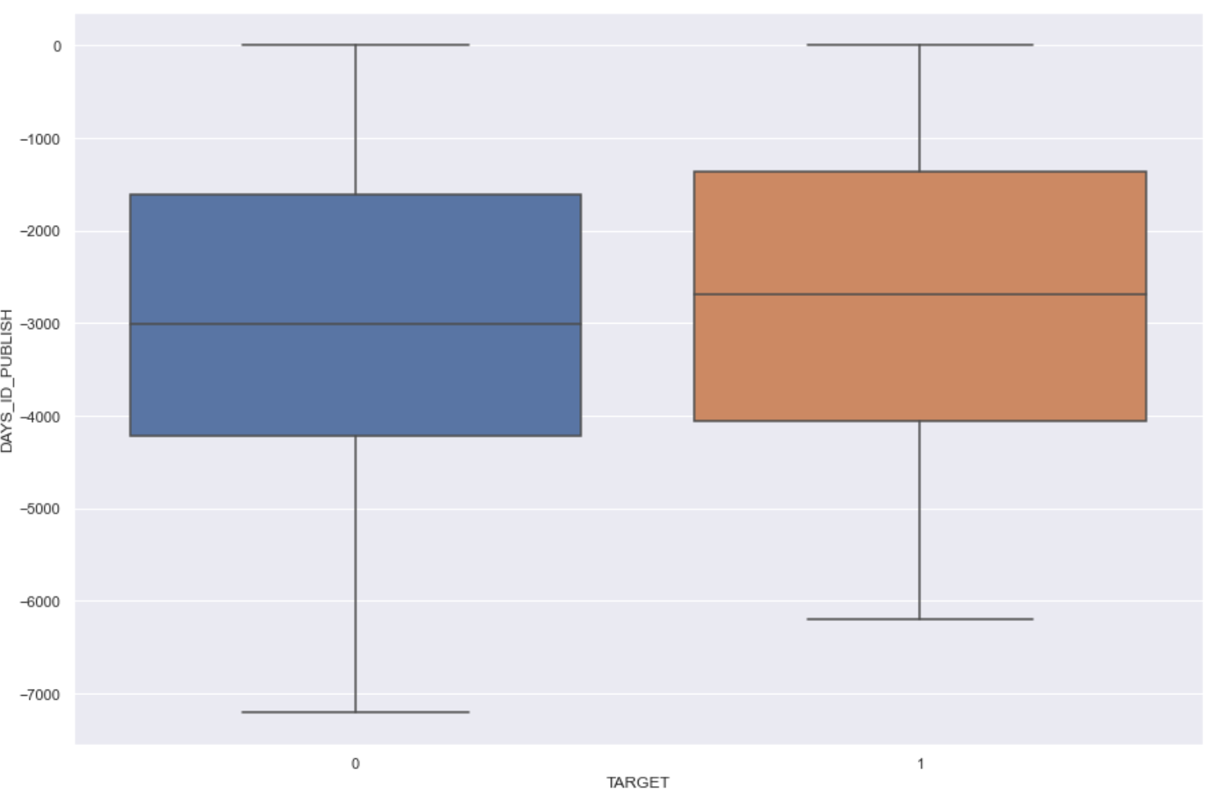
EDA
Applicant changing IDs or Phone was
a good indicator of defaulter
Larger loans virtually had no default
Notes:
Delete in final ppt

Slide 13
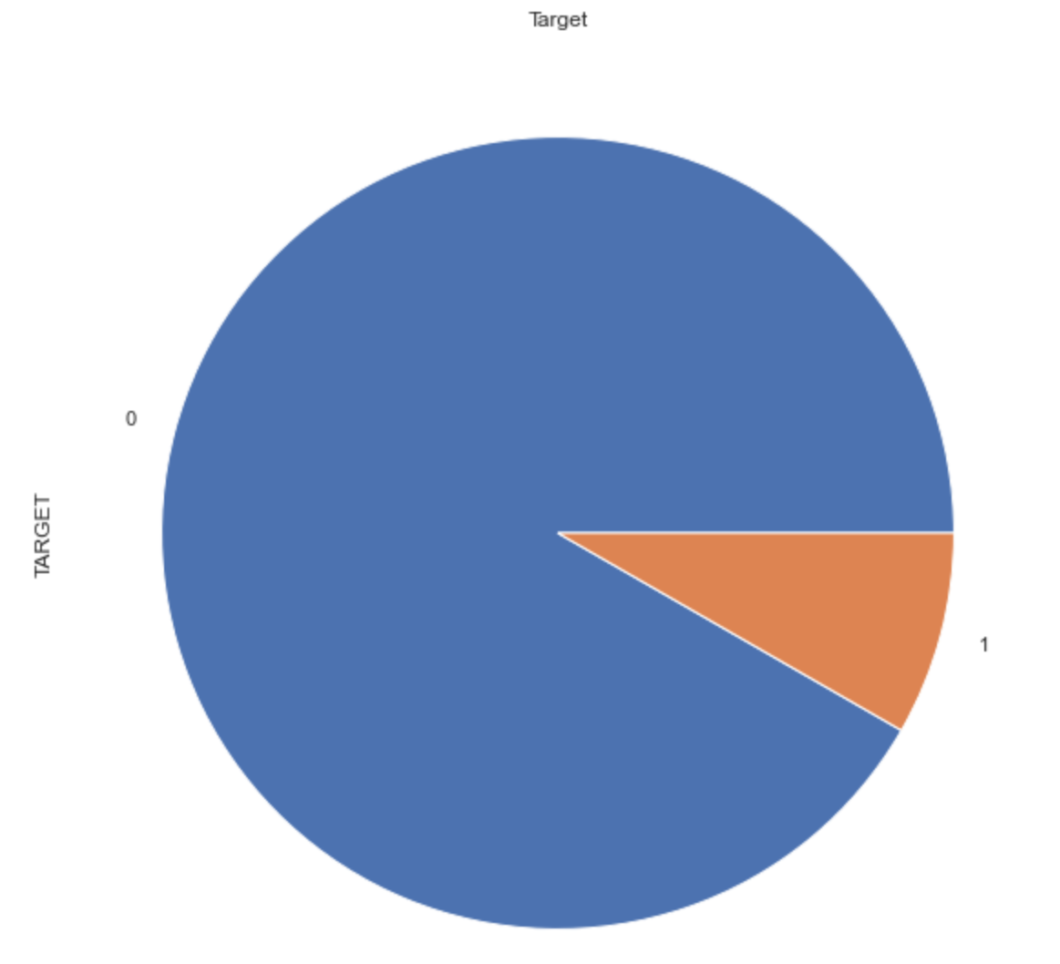
EDA and Preprocessing
The data was skewed:
target
Target | Count
Not Default (0) | 199298
Default(1) | 18037
We have oversampled to skewed data
Notes:
Delete in final ppt

Slide 14







The AI Canvas
*AI Canvas
What task/decision are you examining?
This data set is uploaded in order to get the insights of Credit card Defaultees based on the respective attributes. The consumer lending line of business @ JPMC is in the business of lending money to customers for loans, credit cards, mortgage, etc. and a model like this which can predict potential defaults would be immensely helpful in making lending decisions. The aim of the project is to provide this service, based on a ML model, which will be repeatable, scallable and retrainable.
Prediction
Judgment
Action
Outcome
Idea is to predict the future customer, to see if he will default on a loan or a credit card.
If you are right , you will be able to save the firm from the loaning to a bad customer.
If you are wrong you may lose out on a prospective customer.
What are the actions that can be chosen?
A customer’s application can be approved or declined based on the inputs provided.
Choose the measure of performance that you want to use to judge whether you are achieving your outcomes.
Accuracy on the testing data is the main criteria here.
Training
Input
Feedback
What data do you need on past inputs, actions and outcomes in order to train your AI and generate better predictions?
DAYS_EMPLOYED
DAYS_BIRTH
DAYS_ID_PUBLISH
DAYS_LAST_PHONE_CHANGE
AMT_ANNUITY
AMT_CREDIT
AMT_INCOME_TOTAL
AMT_GOODS_PRICE
AMT_REQ_CREDIT_BUREAU_YEAR
OBS_30_CNT_SOCIAL_CIRCLE
How can you use measured outcomes along with input data to generate improvements to your predictive algorithm?
We used the most impactful features in the model to train and test against input data to improve the accuracy.
What data do you need to generate predictions once you have an AI algorithm trained?
DAYS_EMPLOYED
DAYS_BIRTH
DAYS_ID_PUBLISH
DAYS_LAST_PHONE_CHANGE
AMT_ANNUITY
AMT_CREDIT
AMT_INCOME_TOTAL
AMT_GOODS_PRICE
AMT_REQ_CREDIT_BUREAU_YEAR
OBS_30_CNT_SOCIAL_CIRCLE
A customer’s application can be approved or declined based on the inputs provided. AI will not replace the staff, but will help in better decision making and tremendously improve the decision timing. Also it will bring consistency in the decision making process and provide additional scalability and easy maintainability. The staff feedback can help improve the AI.
© Agrawal, Gans, Goldfarb 2019
Notes:
Delete in final ppt

Slide 15
Data Set
Data set is from Kaggle : https://www.kaggle.com/mishra5001/credit-card
Source:
International Institute of Information Technology Bangalore
The Data was collected as part of Social Experiment to provide public inferences of how a person applying for Loan can get it completed in a minimal amount of time. Also, adhering to the facts as which type of customers fail to repay the installments or full loan and provide inference so that the person applying for loan does not falls into that category.
Description from Kaggle:
Motive!
This data set is uploaded in order to get the insights of Credit card Defaultees based on the respective attributes!
Inside?
We have attributes such as IncomeTotal,AMTAPPLICATION,AMT_CREDIT and around 122 Columns in Application Data Set. The interesting thing is if you intend to see the patterns and variations, we can use the PREVIOUS APPLICATION data set also, in order to get more insights.!
Inspiration
We took this data set as our assignment and tried to perform the EDA to the best of our capability!
Notes:
Delete in final ppt

